Slide 1
Mobile Programming Final Exam
Shukirillaev Mukhammadsodik 202438379

Slide 2
Theory Questions

Slide 3
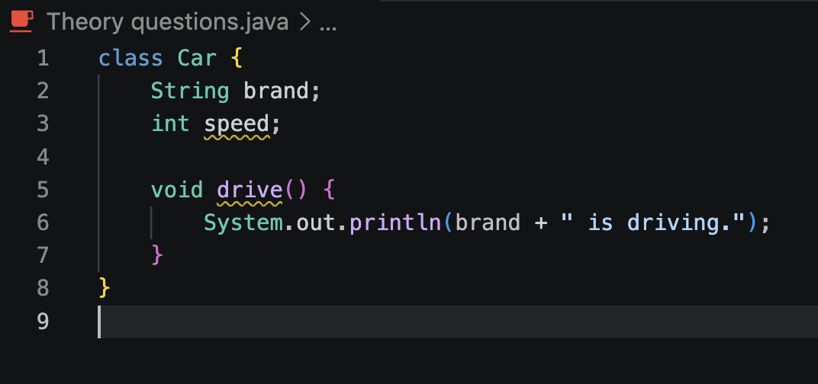
Class
A class is a blueprint or template that defines the properties (fields) and behaviors (methods) of objects. It doesn't hold data itself, it just describes the structure. As you can see on the screenshot, there structure doesn’t hold the data but just gives a blueprint

Slide 4
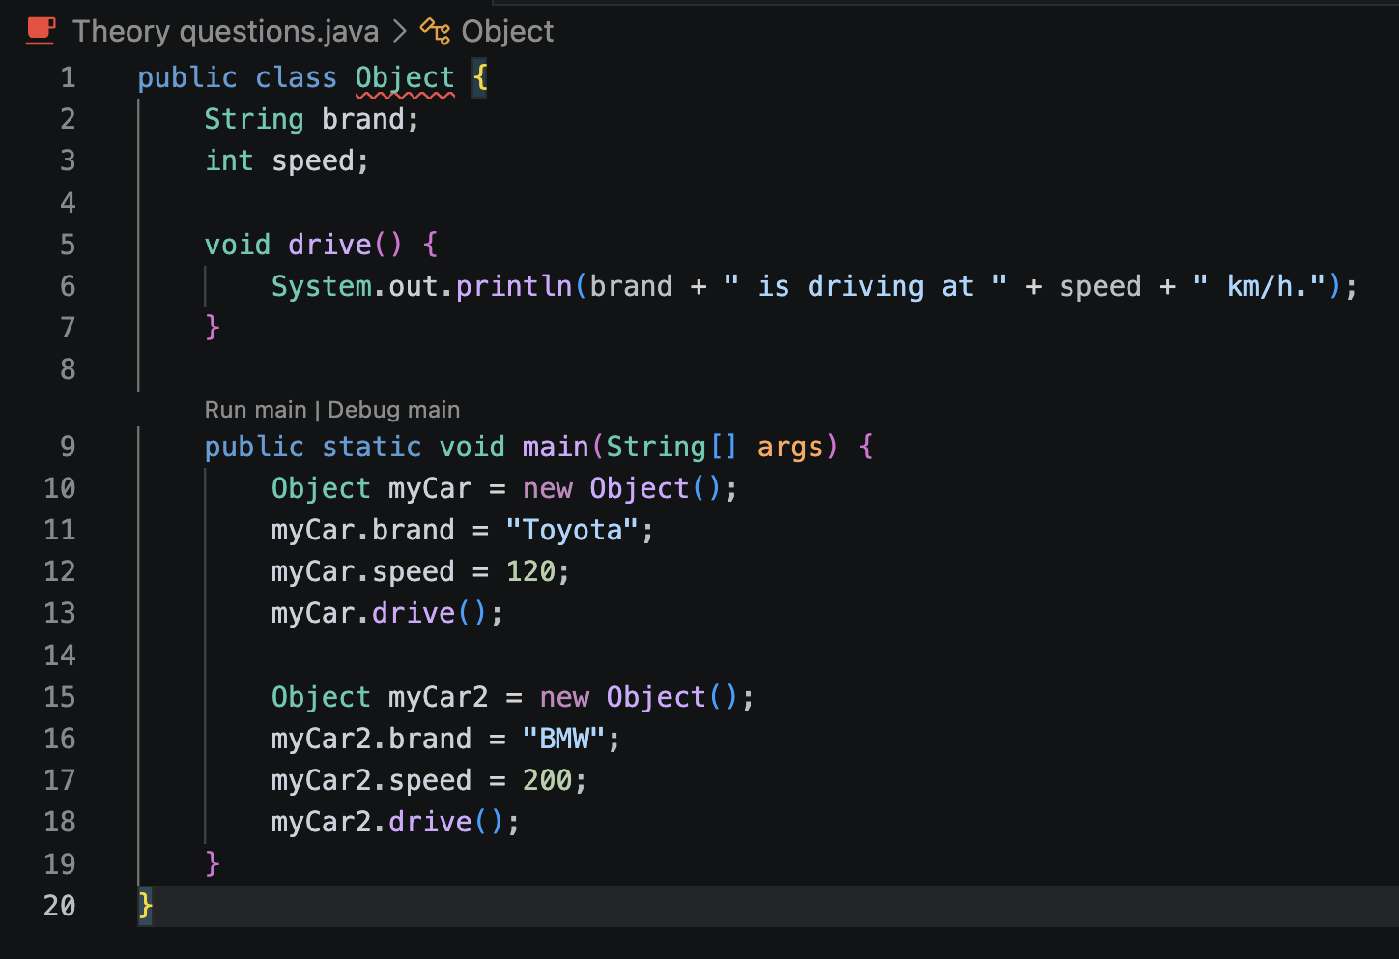
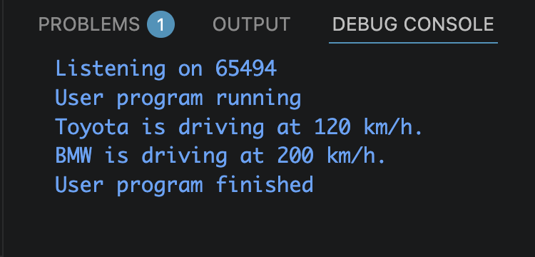
Object
An object is an instance of a class a concrete entity created from the blueprint, with actual data stored in memory. You can see it on the screenshot:

Slide 5
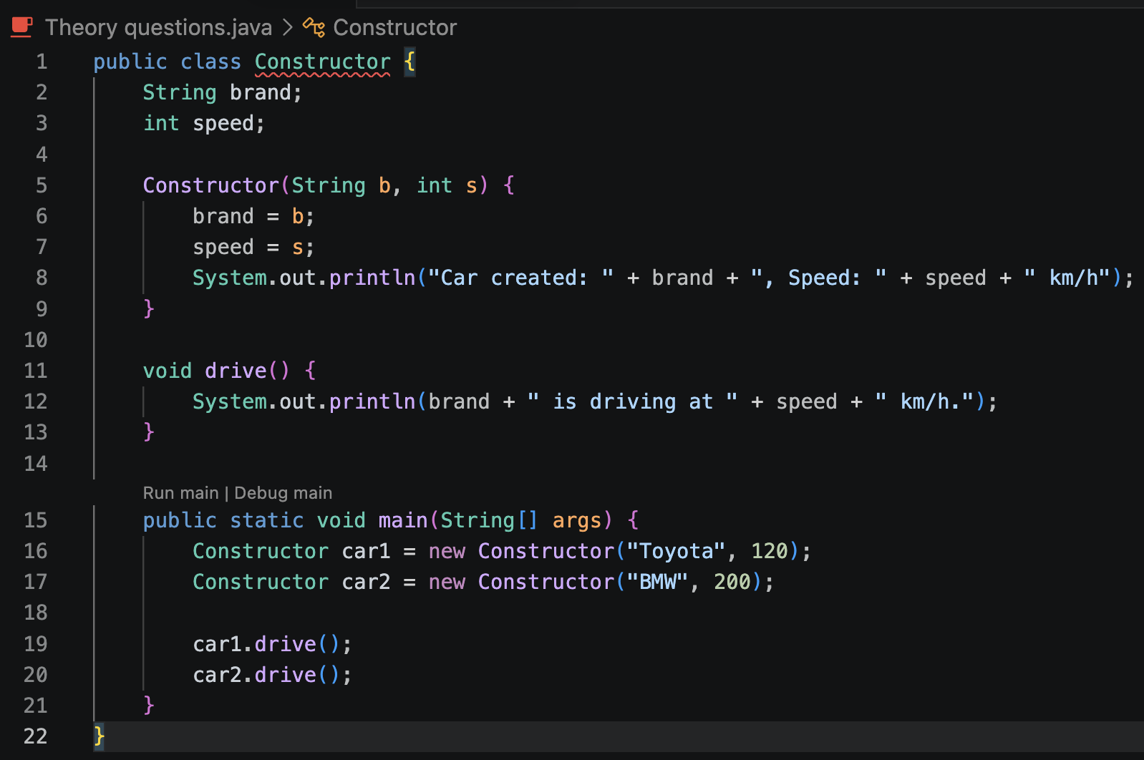
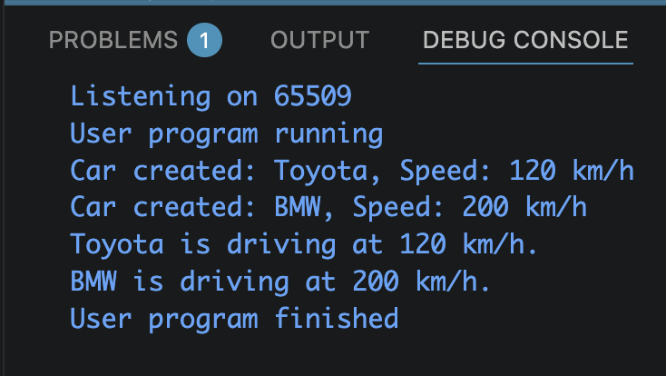
Constructor
A constructor is a special method that runs automatically when an object is created. It has the same name as the class and no return type. It's used to initialize the object's fields. And here is the example:

Slide 6
Coding Question
Simple Calculator

Slide 7
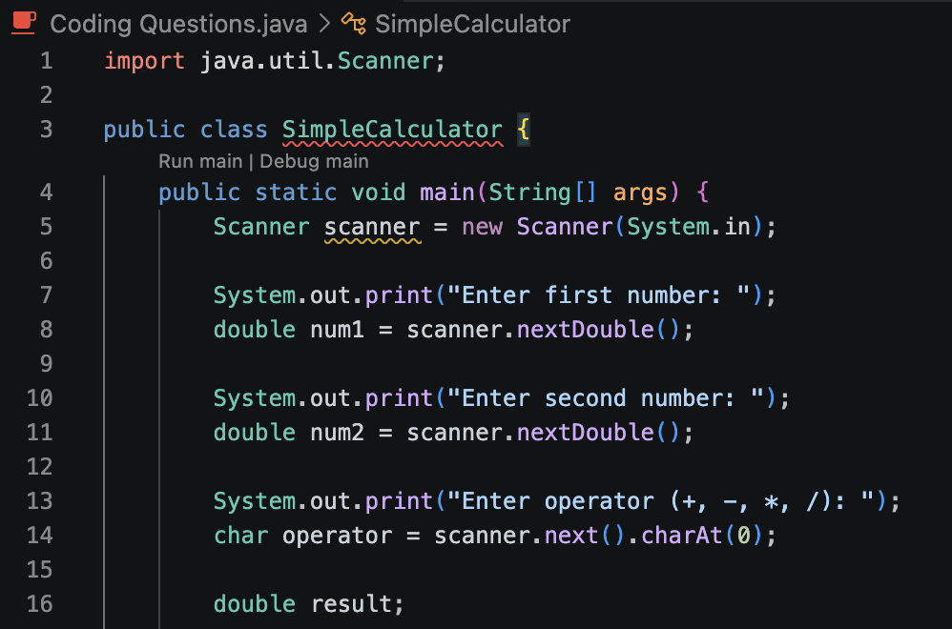
Simple Calculator
In this program, I used the Scanner class to take input from the user specifically two numbers and an operator symbol. I stored the numbers as double so the calculator can handle decimal values, and the operator as a char since it's a single character.

Slide 8
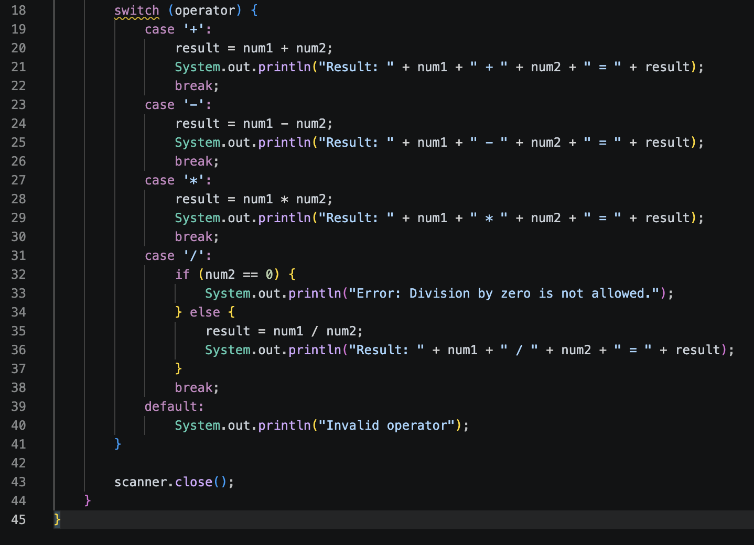
Simple Calculator
For the logic, I chose a switch because it's cleaner than multiple if-else blocks when checking one variable against specific values. Each case handles one operator: addition, subtraction, multiplication, and division. For the division case, I added an extra check to catch division by zero and print an error instead of crashing. If the user enters anything that isn't one of the four operators, the default case prints "Invalid operator".
Finally, I called scanner.close() at the end to free up the resource after input is done.

Slide 9
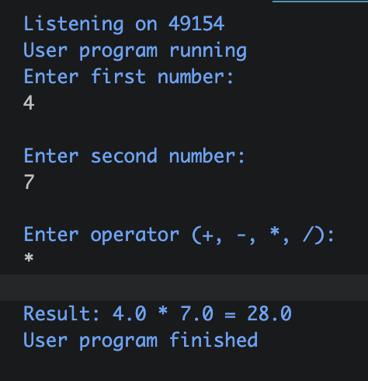
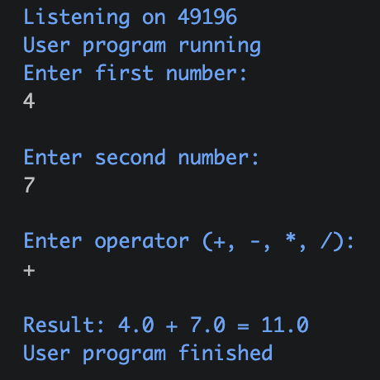
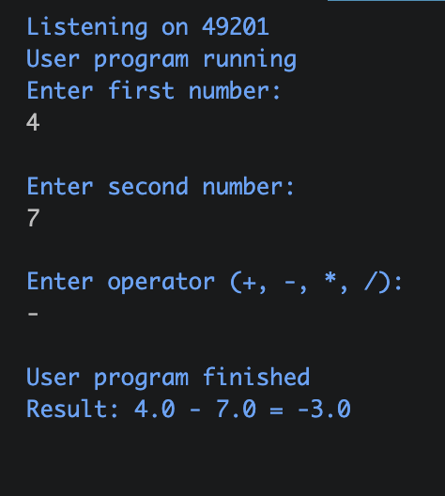
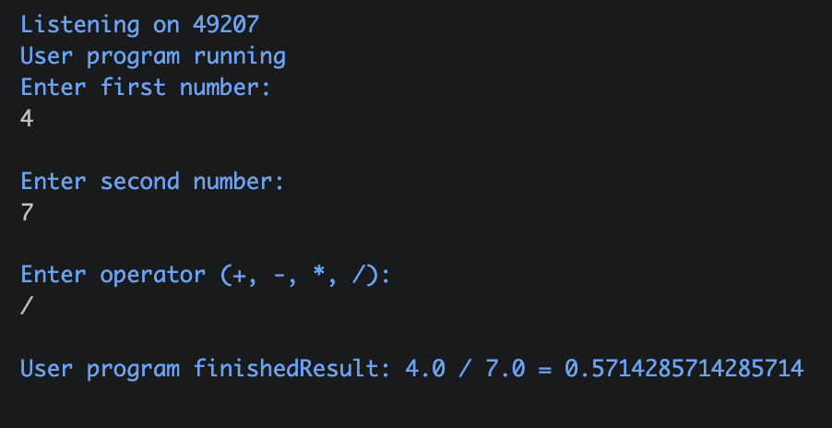
Outputs:

Slide 10
Coding Question 2
Student Object

Slide 11
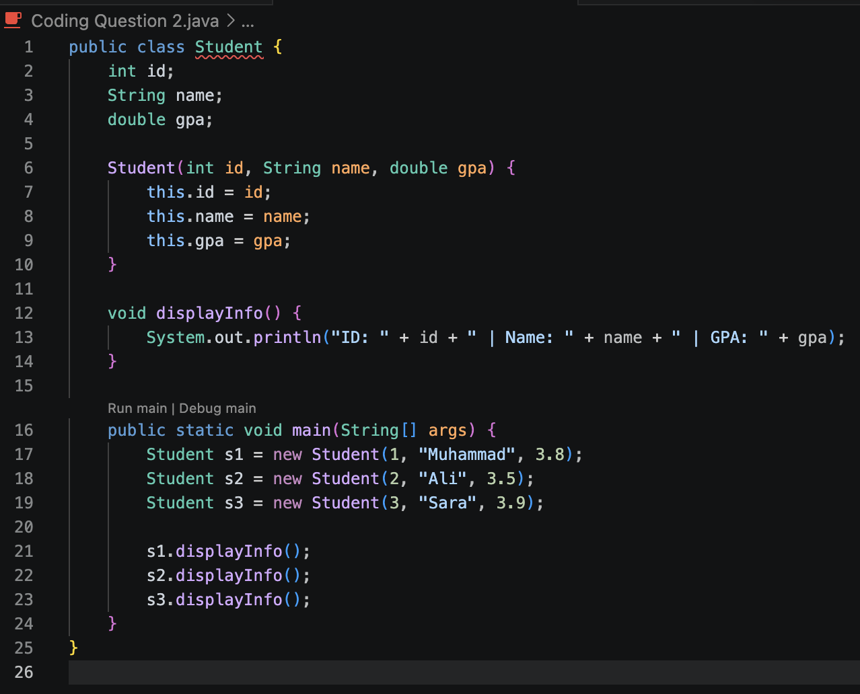
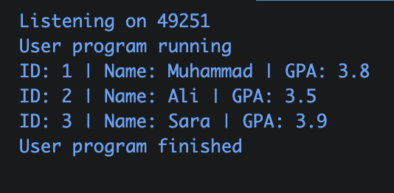
I created a Student class that holds three pieces of information about a student: their ID, name and GPA.
Instead of setting each field manually after creating the object, I wrote a constructor so that I can pass all the values directly when creating the object, which is cleaner and faster as I mentioned on the simple calculator above.
I also added a displayInfo() method to avoid repeating the same print line for every student: I just call the method and it handles the printing. Then I created 3 student objects in main and called displayInfo() on each one to show their details.

